Slide 1

AWS Architecture Icons
FOR DARK BACKGROUNDS
Release 6.0-2020.1.31

Slide 2
Release 6.0-2020.1.31: What’s new?
For the latest deck, asset packages, or resources, visit the AWS Architecture Center: https://aws.amazon.com/architecture/icons/
Firewall resource icon (slide 24)
Amazon EventBridge resource icons (slide 32)
Default event bus
Custom event bus
SaaS event bus
AWS Express Workflows (slide 32)
AWS Wavelength (slide 47)
AWS Compute Optimizer (slide 48)
AWS Local Zones (slide 48)
EC2 Image Builder (slide 48)
Amazon Managed Apache Cassandra Service (slide 57)
AWS DeepComposer (slide 78)
Amazon Augmented AI (slide 78)
Amazon Fraud Detector (slide 79)
Amazon Kendra (slide 79)
Amazon CodeGuru (slide 86)
Quantum Technologies category (slide 104)
Amazon Braket (slide 104)
Finding resource icon (slide 113)
Amazon Detective (slide 114)

Slide 3
Contents
Introduction
System
Guidelines
Elements
Examples

Slide 4

Introduction
About the deck, and guidance for getting started

Slide 5






About AWS Architecture Icons
Architecture diagrams are a great way to communicate your design, deployment, and topology.
In this deck, you will find an official collection of AWS service icons, resources, and other tools to help you build customer-focused and consistent AWS Architecture diagrams.
Customers and partners are permitted by AWS to use the icons to create architecture diagrams. They are designed to be simple so that you can easily incorporate them in your diagrams and put them in your whitepapers, presentations, datasheets, posters, or any technical material you like.
AWS Cloud
Availability Zone 1
Availability Zone 2
VPC
NAT gateway
Amazon EC2 Auto Scaling
NAT gateway
Auto Scaling group
Instance
Instance
Auto Scaling group
Instance
Instance

Slide 6
Before you begin:
1
2
3
Check for the
latest deck update
Read the guidelines
When in doubt,
see the examples
For specific element guidance and best practices, see the guidelines.
Download the
latest deck from the
AWS Architecture Center.
For completed diagrams, jump to the example pages. If you’re having trouble with a particular layout or object, use these as a blueprint.

Slide 7
System
An all-up look at the diagram system

Slide 8




System elements
AWS Cloud
Groups
Arrows
Service icons
Show the connection between multiple services or resources
Describe a flow of information or connect different parts of a diagram
Represent an AWS service
Resource icons
General resource icons
Represent an AWS service resource
Apply to multiple services or categories

Slide 9
System elements
Group icon
AWS Cloud
Layered groups
Availability Zone 1
Availability Zone 2
VPC
Service icon
NAT gateway
Amazon EC2 Auto Scaling
NAT gateway
Auto Scaling group
Instance
Instance
Resource icon
Auto Scaling group
Instance
Instance

Slide 10
Guidelines
Diagram and element guidance

Slide 11
Building a diagram
Choose your deck style The architecture deck is available for both light and dark backgrounds. Determine which best fits your need–light backgrounds tend to be used on the web, whereas dark backgrounds are used for in-person presentations or slide decks.
Start with the structure Locate the groups to use for the underlying structure of your diagram.
Add service and resource icons Navigate to the category of your desired service icon or resource, or use the search capability to locate it. Then, copy and paste it into your diagram.
Add other steps Does your diagram include external users or devices? Use resources to add depth or context to your diagram.
Connect the steps Use the preset arrows to connect your steps and describe a workflow.

Slide 12
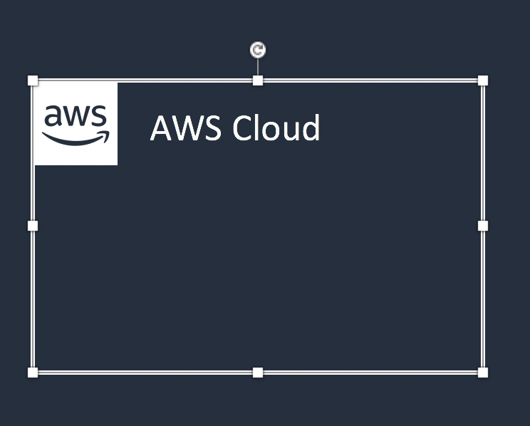


Groups
Each group consists of an icon and a label. Colors and lines help differentiate groups to make it easier for the user to read a diagram at a glance. Some groups cross multiple other groups, such as Auto Scaling, whereas others are meant to layer inside one another, such as a VPC and subnets.
Resizing groups
Layering groups
Use the bottom-right corner of a group box to stretch or collapse to your desired size.
When you have groups within groups, each inner group should have about 0.05” buffer on each side.
DO:
Hold Shift down while resizing an icon to maintain a square.
Use a generic group type if the presets do not suit your needs.
VPC
Public subnet
DON’T:
Create new group icons.

Slide 13



Icons
Primary service and resource icons are designed to be used on both dark and light backgrounds. Alternate service icons are specific to a background type. All icons may be renamed to better fit your use case (see slide 15 for more information).
Resizing icons
Using the alternate service icon
All icons in this deck are SVGs, allowing them to be scaled up or down depending on the diagram. To preserve icon integrity, be sure to hold down Shift while resizing.
DO:
In some complex diagrams, it may be less visually distracting to use the alternate “light-bg” service icons. These are built with a solid color background instead of a gradient and may be used interchangeably at your discretion.
Hold Shift down while resizing.
Change the resource icon text color when using a dark background.
Use the alternate light-bg service icon when appropriate.
DON’T:
Crop service icons.
Flip or rotate icons.
Change icon shapes.
Amazon-Lex.svg
Amazon-Lex_light-bg.svg

Slide 14
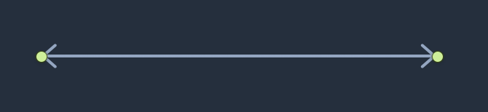
Arrows
Use arrows or lines to connect parts of a diagram or to show a workflow.
Use preset arrows
Create new arrows
Copy the preset arrows into your diagram to maintain the correct formatting. To edit, click on the arrow and hold down Shift.
Preset arrows use the “Open Arrow” in Size 4.
DO:
Use the preset arrows provided in the Elements section.
Use straight lines and right angles to connect objects.
Default Arrow
+ Open Arrow
+ Size 4
When in doubt, use the default
DON’T:
Hold Shift
If the arrow shape that you need is not available in the sample arrows, use the default arrows.
Create diagonal lines.
Use anything beside preset or default arrows.

Slide 15

Text boxes
Service and icon names are separated from the icon itself to allow for adjustment or abbreviation. You may change the size or color of the text, or use the short form of the service name if necessary.
Name wrapping and line breaks
AWS service names should fit on one or two lines. AWS or Amazon should always be accompanied by the service name. Lines should never break mid-word.
DO:
Modify color or text size if necessary.
Break a line after the second word in the service name.
Amazon Elasticsearch Service
Amazon
Elasticsearch Service
Amazon
Elastic-
search Service
DON’T:
Amazon should be on the same line as the first word in the service name.
Use short forms without first mentioning the full service name somewhere in the document.
Duplicate short forms for different services, such as ELB for Elastic Beanstalk and Elastic Load Balancing.
Break a line in the middle of a word.
Lines should never break mid-word, and should fit on two lines max.
Short forms
To save space when using a service multiple times in a diagram, you may use the short service forms instead of the full name. For example, Amazon ES.

Slide 16
Examples
The system in action

Slide 17




Example:
Git to S3 Webhooks
AWS Cloud
Amazon S3
SSH key bucket
Git push
Third-party Git repository
Git webhook
Git users
AWS KMS key
AWS Lambda
AWS Lambda
Amazon S3 output bucket

Slide 18

Example:
Chef Automate Architecture on AWS
AWS Cloud
Availability Zone
VPC
Internet gateway
Public subnet
Chef Knife is used to upload cookbooks
Knife is used to bootstrap and communicate with nodes
Chef-client processes run-list
1
Chef Automate
3
2
Chef workstation (local Chef repo)
Chef node
10.0.0.0/19
10.0.0.0/16

Slide 19
Elements
Groups, arrows, resource icons, and service icons to use when building your diagram

Slide 20
Icon categories
Click a category to jump to slide (must be in Presentation mode)
General Resources
Analytics
Application Integration
AR & VR
AWS Cost Management
Blockchain
Business Applications
Compute
Customer Enablement
Customer Engagement
Database
Developer Tools
End User Computing
Game Tech
Internet of Things
Machine Learning
Management & Governance
Media Services
Migration & Transfer
Mobile
Networking & Content Delivery
Quantum Technologies
Robotics
Satellite
Security, Identity, & Compliance
Storage

Slide 21
General resources

Slide 22








Groups
1/3
AWS Cloud
AWS Cloud
Region
Availability Zone
Security group
Auto Scaling group
VPC
Private subnet
Public subnet
Server contents
Corporate
data center
Elastic Beanstalk container
EC2 instance contents
Spot Fleet
AWS Step Functions workflow
Generic group
Generic group

Slide 23
Arrows
2/3

Slide 24

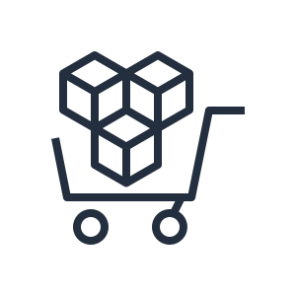

















General icons
3/3
AWS Marketplace
AWS Marketplace
Client
Disk
Forums
Generic database
Internet
Internet alt1
Internet alt2
Mobile client
Firewall
Multimedia
Office building
SAML token
SSL padlock
Tape storage
Traditional server
User
Users
Toolkit
SDK

Slide 25


Analytics

Slide 26




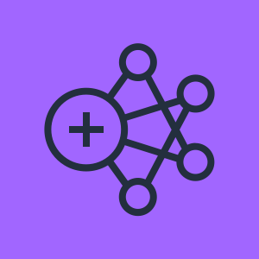


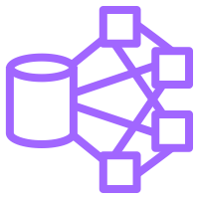
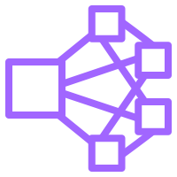

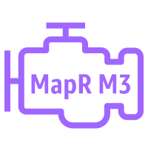
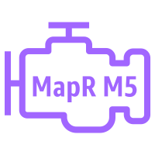
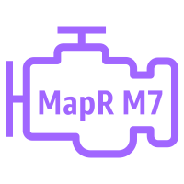
Analytics
1/4
Amazon CloudSearch
Amazon EMR
Amazon Kinesis
Amazon CloudSearch
Amazon EMR
Amazon Kinesis
Search documents
HDFS cluster
Cluster
EMR engine
EMR engine MapR M3
EMR engine MapR M5
EMR engine MapR M7

Slide 27








Analytics
2/4
Amazon Kinesis
Video Streams
Amazon Kinesis
Data Streams
Amazon Kinesis
Data Firehose
Amazon Kinesis
Data Analytics
Amazon Kinesis
Video Streams
Amazon Kinesis
Data Streams
Amazon Kinesis
Data Firehose
Amazon Kinesis
Data Analytics

Slide 28








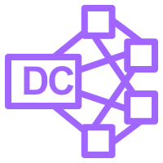

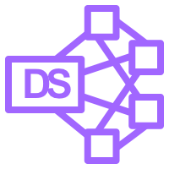
Analytics
3/4
AWS Glue
Amazon Athena
Amazon Elasticsearch Service
Amazon Redshift
AWS Glue
Amazon Athena
Amazon Elasticsearch Service
Amazon Redshift
Crawler
Dense compute node
AWS Glue Data Catalog
Dense storage node

Slide 29









Analytics
4/4
Amazon QuickSight
AWS Lake Formation
AWS Data Pipeline
Amazon Managed Streaming for Kafka
Amazon QuickSight
AWS Lake Formation
AWS Data Pipeline
Amazon Managed Streaming for Kafka
Data lake

Slide 30


Application Integration

Slide 31



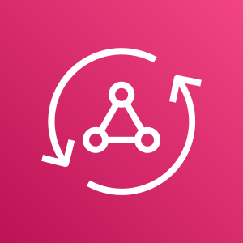









Application Integration
1/2
Amazon Simple Notification Service
Amazon Simple Queue Service
Amazon MQ
AWS AppSync
Amazon Simple Notification Service
Amazon Simple Queue Service
Amazon MQ
AWS AppSync
Email notification
Message
HTTP notification
Queue
Topic

Slide 32







Application Integration
2/2
AWS Step Functions
Amazon EventBridge
AWS Console Mobile Application
AWS Express Workflows
AWS Step Functions
Amazon EventBridge
AWS Console Mobile Application
AWS Express Workflows
Default
event bus
Event
Custom
event bus
SaaS
event bus

Slide 33


AR & VR

Slide 34
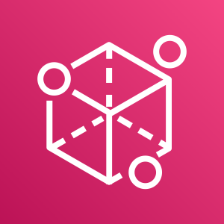

AR & VR
1/1
Amazon Sumerian
Amazon Sumerian

Slide 35


AWS Cost Management

Slide 36








AWS Cost Management
1/1
AWS Budgets
AWS Cost & Usage Report
AWS Cost Explorer
Reserved Instance Reporting
AWS Budgets
AWS Cost & Usage Report
AWS Cost Explorer
Reserved Instance Reporting

Slide 37


Blockchain

Slide 38





Blockchain
1/1
Amazon Managed Blockchain
Amazon Quantum Ledger Database
Amazon Managed Blockchain
Amazon Quantum Ledger Database
Blockchain

Slide 39


Business Applications

Slide 40






Business Applications
1/1
Alexa for Business
Amazon Chime
Amazon WorkMail
Alexa for Business
Amazon Chime
Amazon WorkMail

Slide 41


Compute

Slide 42



















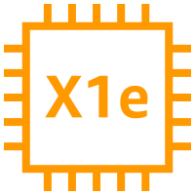





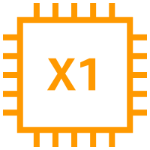





Compute
1/7
AMI
Auto Scaling
Elastic IP address
Rescue
Amazon EC2
Instance
A1 instance
M4 instance
R5a instance
z1d instance
H1 instance
Amazon EC2
Instances
T3 instance
C5 instance
R4 instance
P3 instance
I3 instance
Spot Instance
T2 instance
C5n instance
X1e instance
P2 instance
D2 instance
Instance with CloudWatch
M5 instance
C4 instance
X1 instance
G3 instance
M5a instance
R5 instance
High Memory instance
F1 instance
DB instance

Slide 43














Compute
2/7
Amazon EC2 Auto Scaling
Amazon Application
Auto Scaling
Amazon Elastic Container Registry
Amazon Elastic Container Service
Amazon EC2 Auto Scaling
Amazon Application
Auto Scaling
Amazon Elastic Container Registry
Amazon Elastic Container Service
Registry
Container 1
Container 2
Container 3
Image
Service
Task

Slide 44










Compute
3/7
AWS Elastic Beanstalk
AWS Lambda
Amazon Elastic Kubernetes Service
Amazon Lightsail
AWS Elastic Beanstalk
AWS Lambda
Amazon Elastic Kubernetes Service
Amazon Lightsail
Deployment
Lambda function
Application

Slide 45








Compute
4/7
AWS Batch
AWS Fargate
AWS Outposts
AWS Serverless Application Repository
AWS Batch
AWS Fargate
AWS Outposts
AWS Serverless Application Repository

Slide 46








Compute
5/7
VMware Cloud on AWS
AWS Thinkbox Deadline
AWS Thinkbox XMesh
AWS Thinkbox Frost
VMware Cloud on AWS
AWS Thinkbox Deadline
AWS Thinkbox XMesh
AWS Thinkbox Frost

Slide 47






Compute
6/7
AWS Thinkbox Krakatoa
AWS Thinkbox Sequoia
AWS Thinkbox Stoke
AWS Wavelength
AWS Thinkbox Krakatoa
AWS Thinkbox Sequoia
AWS Thinkbox Stoke
AWS Wavelength

Slide 48
Compute
7/7
AWS Compute Optimizer
AWS Local Zones
EC2 Image Builder
AWS Compute Optimizer
AWS Local Zones
EC2 Image Builder

Slide 49


Customer Enablement

Slide 50








Customer Enablement
1/1
AWS IQ
AWS Managed Services
AWS Professional Services
AWS Support
AWS IQ
AWS Managed Services
AWS Professional Services
AWS Support

Slide 51


Customer Engagement

Slide 52







Customer Engagement
1/1
Amazon Connect
Amazon Pinpoint
Amazon Simple Email Service
Amazon Connect
Amazon Pinpoint
Amazon Simple Email Service
Email

Slide 53


Database

Slide 54

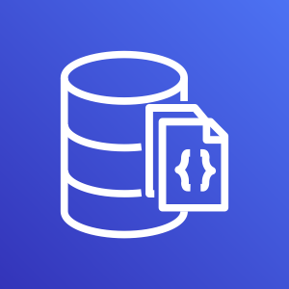











Database
1/5
Amazon Aurora
Amazon DocumentDB (with MongoDB compatibility)
Amazon DynamoDB
Amazon Aurora
Amazon DocumentDB (with MongoDB compatibility)
Amazon DynamoDB
Resource icons on slide 53
Attribute
Items
Amazon DynamoDB Accelerator (DAX)
Item
Table
Attributes
Global secondary index

Slide 55


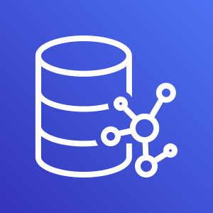





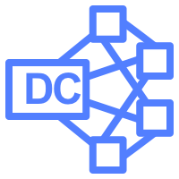

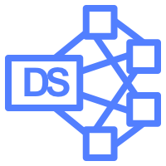
Database
2/5
Amazon Redshift
AWS Database Migration Service
Amazon Neptune
Amazon Quantum Ledger Database
Amazon Redshift
AWS Database Migration Service
Amazon Neptune
Amazon Quantum Ledger Database
Dense compute node
Database migration workflow/job
Dense storage node

Slide 56


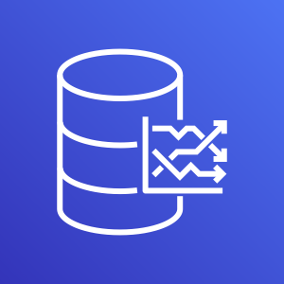








Database
3/5
Amazon RDS
Amazon RDS on VMware
Amazon Timestream
Amazon ElastiCache
Amazon RDS
Amazon RDS on VMware
Amazon Timestream
Amazon ElastiCache
Cache node
ElastiCache for Redis
ElastiCache for Memcached

Slide 57
Database
4/5
Amazon Managed Apache Cassandra Service
Amazon Managed Apache Cassandra Service

Slide 58











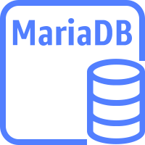



Database
5/5
Amazon Aurora instance
Amazon Aurora
instance alternate
Amazon RDS instance
Amazon RDS instance alternate
MySQL instance
MySQL instance alternate
Oracle instance
Oracle instance alternate
PostgreSQL instance
PostgreSQL
instance alternate
PIOPS
MariaDB instance
MariaDB instance alternate
SQL Server instance
SQL Server instance alternate

Slide 59


Developer Tools

Slide 60









Developer Tools
1/3
AWS Cloud9
AWS CodeBuild
AWS CodeCommit
AWS CodeDeploy
AWS Cloud9
AWS CodeBuild
AWS CodeCommit
AWS CodeDeploy
AWS Cloud9

Slide 61



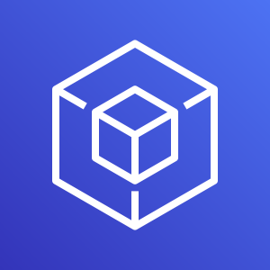




Developer Tools
2/3
AWS CodePipeline
AWS CodeStar
AWS Command Line Interface
AWS Tools and SDKs
AWS CodePipeline
AWS CodeStar
AWS Command Line Interface
AWS Tools and SDKs

Slide 62

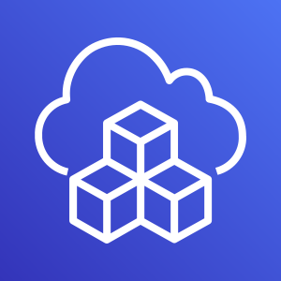

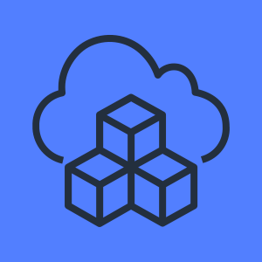
Developer Tools
3/3
AWS X-Ray
AWS Cloud Development Kit
AWS X-Ray
AWS Cloud Development Kit

Slide 63


End User Computing

Slide 64

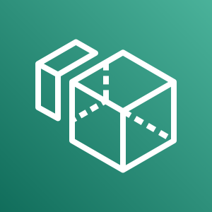



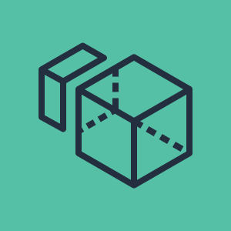


End User Computing
1/1
Amazon AppStream 2.0
Amazon WorkSpaces
Amazon WorkLink
Amazon WorkDocs
Amazon AppStream 2.0
Amazon WorkSpaces
Amazon WorkLink
Amazon WorkDocs

Slide 65


Game Tech

Slide 66


Game Tech
1/1
Amazon GameLift
Amazon GameLift

Slide 67


Internet of Things

Slide 68













Internet of Things
1/5
Amazon FreeRTOS
AWS IoT 1-Click
AWS IoT Analytics
AWS IoT Button
Amazon FreeRTOS
AWS IoT 1-Click
AWS IoT Analytics
AWS IoT Button
Channel
Data set
Pipeline
Notebook
Data store

Slide 69








Internet of Things
2/5
AWS IoT Core
AWS IoT Device Defender
AWS IoT Device Management
AWS IoT Events
AWS IoT Core
AWS IoT Device Defender
AWS IoT Device Management
AWS IoT Events

Slide 70







Internet of Things
3/5
AWS IoT Greengrass
AWS IoT SiteWise
AWS IoT Things Graph
AWS IoT Greengrass
AWS IoT SiteWise
AWS IoT Things Graph
Connector

Slide 71

























Internet of Things
4/5
IOT RESOURCES
IoT action
IoT actuator
IoT certificate
IoT desired state
IoT hardware board
IoT HTTP protocol
IoT HTTP/2 protocol
IoT MQTT protocol
IoT policy
IoT reported state
IoT rule
IoT sensor
IoT servo
IoT
shadow
IoT simulator
IoT topic
Alexa skill
Alexa Voice Service
Alexa-enabled device
Echo
Fire TV
Fire TV stick
Lambda function
Over-the-air update
Device gateway

Slide 72

















Internet of Things
5/5
IOT THINGS
IoT thing bank
IoT thing bicycle
IoT thing camera
IoT thing car
IoT thing cart
IoT thing coffee pot
IoT thing door lock
IoT thing factory
IoT thing generic
IoT thing house
IoT thing lightbulb
IoT thing medical emergency
IoT thing police emergency
IoT thing thermostat
IoT thing travel
IoT thing utility
IoT thing windfarm

Slide 73


Machine Learning

Slide 74







Machine Learning
1/6
Amazon Comprehend
Amazon Elastic Inference
Amazon Forecast
Amazon Lex
Amazon Comprehend
Amazon Elastic Inference
Amazon Forecast
Amazon Lex

Slide 75













Machine Learning
2/6
Amazon Personalize
Amazon Polly
Amazon Rekognition
Amazon SageMaker
Amazon Personalize
Amazon Polly
Amazon Rekognition
Amazon SageMaker
Notebook
Amazon Rekognition image
Model
Amazon Rekognition video
Train

Slide 76








Machine Learning
3/6
Amazon SageMaker Ground Truth
Amazon Textract
Amazon Transcribe
Amazon Translate
Amazon SageMaker Ground Truth
Amazon Textract
Amazon Transcribe
Amazon Translate

Slide 77








Machine Learning
4/6
AWS Deep Learning AMIs
AWS Deep Learning Containers
AWS DeepLens
AWS DeepRacer
AWS Deep Learning AMIs
AWS Deep Learning Containers
AWS DeepLens
AWS DeepRacer

Slide 78
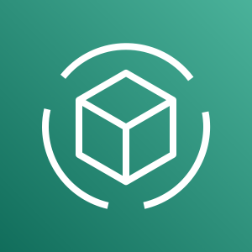

Machine Learning
5/6
Apache MXNet on AWS
TensorFlow on AWS
AWS DeepComposer
Amazon Augmented AI
Apache MXNet on AWS
TensorFlow on AWS
AWS DeepComposer
Amazon Augmented AI

Slide 79
Machine Learning
6/6
Amazon Fraud Detector
Amazon Kendra
Amazon Fraud Detector
Amazon Kendra

Slide 80


Management & Governance

Slide 81















Management & Governance
1/6
Amazon CloudWatch
AWS Auto Scaling
AWS CloudFormation
AWS CloudTrail
Amazon CloudWatch
AWS Auto Scaling
AWS CloudFormation
AWS CloudTrail
Alarm
Event (time-based)
Change set
Stack
Event
(event-based)
Rule
Template

Slide 82








Management & Governance
2/6
AWS Command Line Interface
AWS Config
AWS License Manager
AWS Managed Services
AWS Command Line Interface
AWS Config
AWS License Manager
AWS Managed Services

Slide 83














Management & Governance
3/6
AWS Management Console
AWS OpsWorks
AWS Personal Health Dashboard
AWS Management Console
AWS OpsWorks
AWS Personal Health Dashboard
Apps
Instances
Monitoring
Permissions
Deployments
Layers
Resources
Stack2

Slide 84













Management & Governance
4/6
AWS Service Catalog
AWS Systems Manager
AWS Service Catalog
AWS Systems Manager
Automation
Documents
Patch Manager
Parameter Store
OpsCenter
Inventory
Maintenance Windows
State Manager
Run Command

Slide 85











Management & Governance
5/6
AWS Trusted Advisor
AWS Well-Architected Tool
AWS Control Tower
AWS Trusted Advisor
AWS Well-Architected Tool
AWS Control Tower
Checklist cost
Checklist performance
Checklist security
Checklist fault tolerant
Checklist

Slide 86
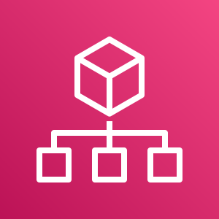
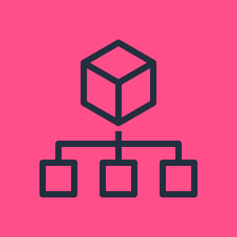


Management & Governance
6/6
AWS Organizations
Amazon CodeGuru
AWS Organizations
Amazon CodeGuru
Account
Organizational unit

Slide 87


Media Services

Slide 88








Media Services
1/3
Amazon Elastic Transcoder
Amazon Kinesis Video Streams
AWS Elemental MediaConnect
AWS Elemental MediaConvert
Amazon Elastic Transcoder
Amazon Kinesis Video Streams
AWS Elemental MediaConnect
AWS Elemental MediaConvert

Slide 89








Media Services
2/3
AWS Elemental MediaLive
AWS Elemental MediaPackage
AWS Elemental MediaStore
AWS Elemental MediaTailor
AWS Elemental MediaLive
AWS Elemental MediaPackage
AWS Elemental MediaStore
AWS Elemental MediaTailor

Slide 90


Media Services
3/3
AWS Elemental Conductor
AWS Elemental Delta
AWS Elemental Live
AWS Elemental Server
AWS Elemental Conductor
AWS Elemental Delta
AWS Elemental Live
AWS Elemental Server

Slide 91


Migration and Transfer

Slide 92









Migration and Transfer
1/3
AWS Application Discovery Service
AWS Database Migration Service
AWS DataSync
AWS Migration Hub
AWS Application Discovery Service
AWS Database Migration Service
AWS DataSync
AWS Migration Hub
Agent

Slide 93








Migration and Transfer
2/3
AWS Server Migration Service
AWS Transfer for SFTP
AWS Snowball
AWS Snowball Edge
AWS Server Migration Service
AWS Transfer for SFTP
AWS Snowball
AWS Snowball Edge

Slide 94
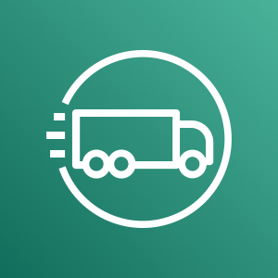



Migration and Transfer
3/3
AWS Snowmobile
CloudEndure Migration
AWS Snowmobile
CloudEndure Migration

Slide 95


Mobile

Slide 96



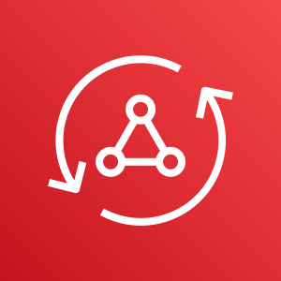





Mobile
1/2
Amazon API Gateway
Amazon Pinpoint
AWS Amplify
AWS AppSync
Amazon API Gateway
Amazon Pinpoint
AWS Amplify
AWS AppSync
Endpoint

Slide 97


Mobile
2/2
AWS Device Farm
AWS Device Farm

Slide 98
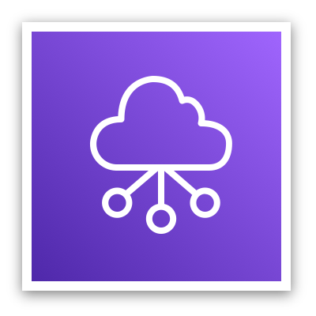

Networking & Content Delivery

Slide 99












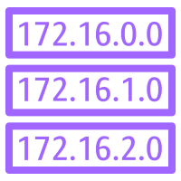

Networking & Content Delivery
1/4
Amazon API Gateway
Amazon CloudFront
Amazon Route 53
AWS PrivateLink
Amazon API Gateway
Amazon CloudFront
Amazon Route 53
AWS PrivateLink
Download distribution
Endpoint
Hosted zone
Edge location
Route table
Streaming distribution

Slide 100














Networking & Content Delivery
2/4
Amazon VPC
Amazon VPC
Customer gateway
Internet gateway
Elastic network interface
Elastic Network Adapter
Endpoints
Router
Traffic Mirroring
NAT gateway
VPN gateway
Flow logs
Network access control list
VPN connection
Peering connection

Slide 101




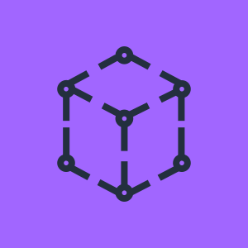



Networking & Content Delivery
3/4
AWS App Mesh
AWS Cloud Map
AWS Direct Connect
AWS Global Accelerator
AWS App Mesh
AWS Cloud Map
AWS Direct Connect
AWS Global Accelerator

Slide 102











Networking & Content Delivery
4/4
AWS Transit Gateway
AWS Client VPN
AWS Site-to-Site VPN
Elastic Load Balancing
AWS Transit Gateway
AWS Client VPN
AWS Site-to-Site VPN
Elastic Load Balancing
Application Load Balancer
Classic Load Balancer
Network Load Balancer

Slide 103

Quantum Technologies

Slide 104
Media Services
1/1
Amazon Braket
Amazon Braket

Slide 105


Robotics

Slide 106






Robotics
1/1
AWS RoboMaker
AWS RoboMaker
Cloud extensions ROS
Development environment
Fleet management
Simulation

Slide 107


Satellite

Slide 108


Satellite
1/1
AWS Ground Station
AWS Ground Station

Slide 109


Security, Identity, and Compliance

Slide 110









Security, Identity, and Compliance
1/5
Amazon Cloud Directory
Amazon Cognito
Amazon GuardDuty
Amazon Inspector
Amazon Cloud Directory
Amazon Cognito
Amazon GuardDuty
Amazon Inspector
Agent

Slide 111









Security, Identity, and Compliance
2/5
Amazon Macie
AWS Artifact
AWS Certificate Manager
AWS CloudHSM
Amazon Macie
AWS Artifact
AWS Certificate Manager
AWS CloudHSM
Certificate authority

Slide 112
















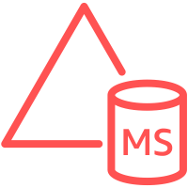

Security, Identity, and Compliance
3/5
AWS Directory Service
AWS Firewall Manager
AWS Identity and Access Management
AWS Directory Service
AWS Firewall Manager
AWS Identity and Access Management
Add-on
AWS STS
MFA token
Simple AD
Long-term security credential
AD Connector
AWS STS (alternate)
Permissions
Encrypted data
Temporary security credential
Data encryption key
Role
AWS Managed Microsoft AD

Slide 113









Security, Identity, and Compliance
4/5
AWS Key Management Service
AWS Secrets Manager
AWS Security Hub
AWS Shield
AWS Key Management Service
AWS Secrets Manager
AWS Security Hub
AWS Shield
Finding
AWS Shield Advanced

Slide 114





Security, Identity, and Compliance
5/5
AWS Single Sign-On
AWS WAF
Amazon Detective
AWS Single Sign-On
AWS WAF
Amazon Detective
Filtering rule

Slide 115


Storage

Slide 116
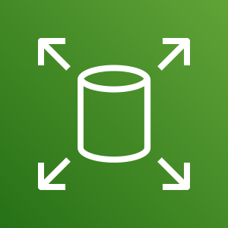

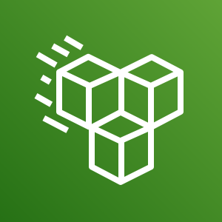
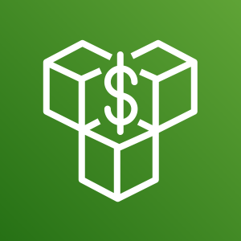


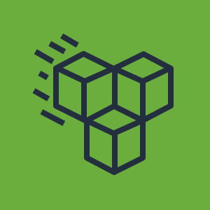





Storage
1/4
Amazon Elastic Block Store
Amazon Elastic File System
Standard Storage Class
Infrequent Access Storage Class
Amazon Elastic Block Store
Amazon Elastic File System
Standard Storage Class
Infrequent Access Storage Class
Snapshot
File system
Volume
Multiple volumes

Slide 117








Storage
2/4
Amazon FSx
Amazon FSx for Lustre
Amazon FSx for Windows File Server
CloudEndure Disaster Recovery
Amazon FSx
Amazon FSx for Lustre
Amazon FSx for Windows File Server
CloudEndure Disaster Recovery

Slide 118

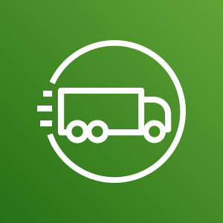



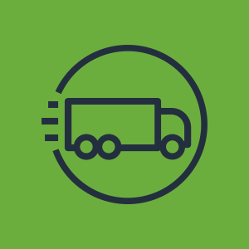





Storage
3/4
AWS Snowball Edge
AWS Snowmobile
AWS Backup
AWS Storage Gateway
AWS Snowball Edge
AWS Snowmobile
AWS Backup
AWS Storage Gateway
Non-cached volume
Cached volume
Virtual tape library

Slide 119

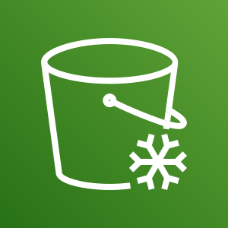









Storage
4/4
Amazon Simple Storage Service
Amazon S3 Glacier
AWS Snowball
Amazon Simple Storage Service
Amazon S3 Glacier
AWS Snowball
Object
Bucket
Archive
Vault
Snowball import-export
Bucket with objects

